Slide 1
Shadow DOM
Trainer: Rex Jones II

Slide 2
Shadow DOM
Video
Introduce The Shadow DOM
Rex Jones II

Slide 3
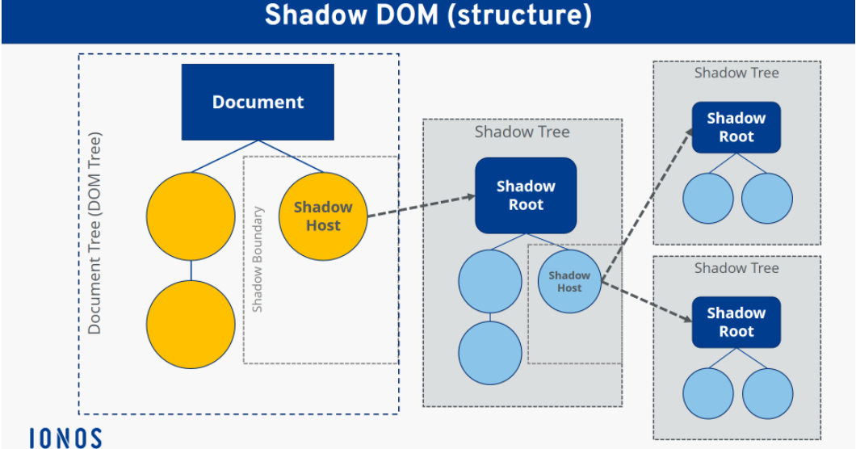

Slide 4
Shadow DOM
Video
Introduce The Shadow DOM
Locate Element Without Using Selenium findElement Method
Locate Element Using Selenium findElement Method
Locate Element Within A Nested Shadow DOM
Rex Jones II

Slide 5
Shadow DOM
Video
Introduce The Shadow DOM
Locate Element Without Using Selenium findElement Method
Locate Element Using Selenium findElement Method
Locate Element Within A Nested Shadow DOM

Slide 6
Shadow DOM
Video
Introduce The Shadow DOM
Locate Element Without Using Selenium findElement Method
Locate Element Using Selenium findElement Method
Locate Element Within A Nested Shadow DOM

Slide 8
Shadow DOM
Video
Introduce The Shadow DOM
Locate Element Without Using Selenium findElement Method
Locate Element Using Selenium findElement Method
Locate Element Within A Nested Shadow DOM

Slide 10
Shadow DOM
Video
Introduce The Shadow DOM
Locate Element Without Using Selenium findElement Method
Locate Element Using Selenium findElement Method
Locate Element Within A Nested Shadow DOM

Slide 12
